Slide 1


Natural Language Processing: Bridging Human-Computer Communication
Natural Language Processing (NLP) is a fascinating field at the intersection of artificial intelligence, linguistics, and computer science. It aims to enable computers to understand, interpret, and generate human language in meaningful ways. As we delve into the world of NLP, we'll explore its core concepts, techniques, applications, and the exciting future that lies ahead.
This journey through NLP will take us from the fundamental building blocks of language processing to cutting-edge technologies that are reshaping how we interact with machines. Whether you're a student, professional, or simply curious about the power of language in the digital age, this exploration will provide valuable insights into the transformative potential of NLP.
by Dr. Tri Basuki Kurniawan

Slide 2

Core Areas of NLP: Syntax
Syntax forms the backbone of language structure, and it's a crucial aspect of NLP. In this domain, computers analyze the grammatical structure of sentences, identifying subjects, predicates, and objects. This process, known as parsing, is fundamental to understanding how words relate to each other within a sentence.
Part-of-speech tagging is another essential syntactic task, where each word in a sentence is labeled with its grammatical category (noun, verb, adjective, etc.). These syntactic analyses enable machines to break down complex language structures, paving the way for more advanced NLP tasks like machine translation and question-answering.
1
Tokenization
Breaking text into individual words or subwords
2
Part-of-Speech Tagging
Assigning grammatical categories to words
3
Parsing
Analyzing the grammatical structure of sentences
4
Dependency Parsing
Identifying relationships between words in a sentence

Slide 3
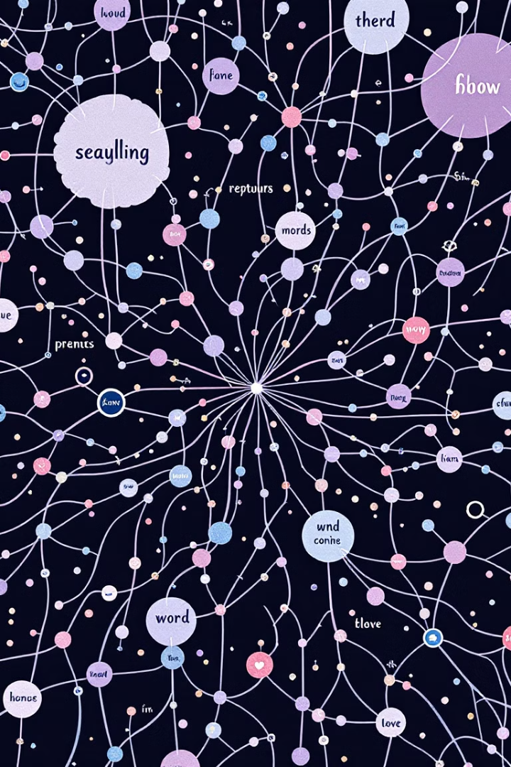
Core Areas of NLP: Semantics
Semantics delves into the meaning of words and phrases, a critical component for machines to truly understand language. This area of NLP focuses on interpreting words in context, resolving ambiguities, and extracting the intended meaning from text or speech.
Semantic analysis involves techniques like word sense disambiguation, which determines the correct meaning of a word with multiple definitions based on its context. Another important aspect is named entity recognition, identifying and classifying named entities (e.g., persons, organizations, locations) in text. These semantic processes enable more sophisticated NLP applications, such as information retrieval and question-answering systems.
Word Sense Disambiguation
Determining the correct meaning of words with multiple definitions based on context
Named Entity Recognition
Identifying and classifying named entities (e.g., persons, organizations, locations) in text
Semantic Role Labeling
Identifying the semantic roles of words or phrases in a sentence (e.g., agent, patient, instrument)

Slide 4

Core Areas of NLP: Pragmatics
Pragmatics in NLP focuses on understanding the intended effect of language beyond its literal meaning. This area deals with how context and real-world knowledge influence the interpretation of language. It's crucial for developing systems that can grasp nuances, implications, and inferences in human communication.
Key aspects of pragmatics include discourse analysis, which examines how sentences connect to form coherent texts, and dialogue systems, which aim to maintain context-aware conversations. Pragmatics also involves understanding figurative language, such as metaphors and idioms, which often carry meanings that differ from their literal interpretations.
1
Context Understanding
Interpreting language based on situational and cultural context
2
Implicature Recognition
Identifying implied meanings that are not explicitly stated
3
Figurative Language Processing
Understanding metaphors, idioms, and other non-literal expressions
4
Dialogue Management
Maintaining coherent and context-aware conversations in dialogue
systems

Slide 5

Core Areas of NLP: Discourse
Discourse analysis in NLP examines how sentences and utterances connect to form coherent and meaningful texts or conversations. This field is crucial for understanding the overall structure and flow of language beyond individual sentences. Discourse analysis helps in tasks such as text summarization, conversation modeling, and long-form content generation.
Key aspects of discourse analysis include coreference resolution, which involves identifying when different words or phrases refer to the same entity, and discourse parsing, which aims to understand the rhetorical structure of the text. These techniques enable NLP systems to maintain coherence in generated text and better understand the relationships between different parts of a document or conversation.
Coreference Resolution
Identifying when different words or phrases refer to the same entity across a text
Discourse Parsing
Analyzing the rhetorical structure and relationships between different parts of a text
Topic Segmentation
Dividing text into coherent segments based on topic shifts
Coherence Modeling
Ensuring logical flow and connection between ideas in generated text

Slide 6



Core Areas of NLP: Speech Processing
Speech processing is a vital component of NLP that bridges the gap between spoken language and text. This field encompasses both speech recognition (converting spoken words to text) and speech synthesis (generating spoken words from text). These technologies are fundamental to creating natural interactions between humans and machines through voice interfaces.
Speech recognition involves complex processes such as acoustic modeling, which maps sound waves to linguistic units, and language modeling, which predicts the likelihood of word sequences. Speech synthesis, on the other hand, focuses on generating natural-sounding speech, considering factors like intonation, rhythm, and emotion. Recent advancements in deep learning have significantly improved the accuracy and naturalness of both speech recognition and synthesis systems.
Speech Recognition
Speech Synthesis
Voice User Interfaces
Converting spoken words to text through acoustic and language modeling
Generating natural-sounding speech from text, considering intonation and rhythm
Enabling natural language interactions through speech-based systems

Slide 7





NLP Techniques: Machine Learning
Machine learning forms the cornerstone of modern NLP systems, enabling computers to learn patterns and make decisions based on data rather than explicit programming. In NLP, machine learning algorithms are trained on large datasets of text or speech to perform tasks such as classification, prediction, and generation.
Common machine learning techniques in NLP include supervised learning, where models are trained on labeled data, and unsupervised learning, which finds patterns in unlabeled data. These approaches power various NLP applications, from sentiment analysis and text classification to machine translation and named entity recognition. The ability of machine learning models to generalize from training data to new, unseen examples makes them particularly valuable in handling the complexities and variabilities of natural language.
Supervised Learning
Training models on labeled data for tasks like sentiment analysis and text classification
Unsupervised Learning
Discovering patterns in unlabeled data, useful for topic modeling and clustering
Reinforcement Learning
Training models through interaction with an environment, applied in dialogue systems
Transfer Learning
Applying knowledge from one task to improve performance on another related task

Slide 8
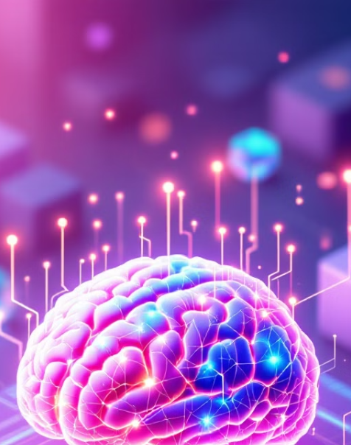




NLP Techniques: Deep Learning
Deep learning, a subset of machine learning based on artificial neural networks, has revolutionized NLP in recent years. These powerful models, capable of learning complex patterns from large amounts of data, have significantly improved the performance of various NLP tasks.
Key deep learning architectures in NLP include Recurrent Neural Networks (RNNs) and their variants like Long Short-Term Memory (LSTM) networks, which are particularly effective for sequential data. More recently, transformer models like BERT and GPT have become state-of-the-art in many NLP tasks, leveraging attention mechanisms to capture long-range dependencies in text. These advanced models have pushed the boundaries of what's possible in language understanding and generation, enabling more natural and context-aware language processing.
Recurrent Neural Networks (RNNs)
Transformer Models
Processing sequential data by maintaining
internal state
Utilizing attention mechanisms for improved context
understanding
Convolutional Neural Networks (CNNs)
Pre-trained Language Models
Extracting local features from text data
Leveraging large-scale pre-training for various downstream
tasks

Slide 9

NLP Techniques: Rule-based Systems
While machine learning and deep learning dominate modern NLP, rule-based systems still play a crucial role in certain applications. These systems use manually crafted rules and lexicons to process and analyze text. They are particularly useful in domains where linguistic patterns are well-defined and consistent, or when interpretability and control over the system's behavior are paramount.
Rule-based approaches often involve creating grammar or pattern-matching rules to extract information or perform specific tasks. They can be highly effective for tasks like named entity recognition in specialized domains, or for handling specific linguistic phenomena. Despite their limitations in scalability and adaptability compared to machine learning methods, rule-based systems offer transparency and predictability, making them valuable in scenarios where explainability is critical, such as in legal or medical applications.
Approach
Advantages
Regular Expressions
Simple, fast pattern matching
Context-Free Grammars
Structured parsing of text
Lexicon-based Methods
Precise control over vocabulary
Finite-State Transducers
Efficient for certain language tasks
Limitations
Limited complexity handling
Difficulty with ambiguity
Labor-intensive to maintain
Limited expressiveness

Slide 10

NLP Applications: Machine Translation
Machine translation is one of the most impactful applications of NLP, breaking down language barriers and facilitating global communication. Modern machine translation systems use advanced neural network architectures, particularly sequence-to-sequence models with attention mechanisms, to translate text from one language to another with impressive accuracy.
These systems learn to map sentences in the source language to their equivalents in the target language, considering not just word-for-word translations but also capturing context and idiomatic expressions. Recent advancements include multilingual models capable of translating between multiple language pairs and zero-shot translation, where the model can translate between language pairs it wasn't explicitly trained on. Despite significant progress, challenges remain in handling low-resource languages and maintaining coherence in long-form translations.
1
Rule-based MT
3
Neural MT
Early systems using linguistic
rules for translation
Deep learning-based models for
improved fluency
2
Statistical MT
4
Transformer-based MT
Probabilistic models trained on
parallel corpora
State-of-the-art models using
attention mechanisms

Slide 11

NLP Applications: Sentiment Analysis
Sentiment analysis, also known as opinion mining, is a crucial NLP application that determines the emotional tone behind a series of words. This technology is widely used to understand customer opinions, monitor brand reputation, and gauge public sentiment on social media platforms.
Modern sentiment analysis systems employ sophisticated machine learning models, often based on deep learning architectures, to classify text as positive, negative, or neutral. Advanced systems can detect more nuanced emotions and even identify sarcasm or irony. These models are trained on large datasets of labeled text, learning to associate words, phrases, and patterns with different sentiments. The applications of sentiment analysis are diverse, ranging from market research and customer service to political analysis and product development.
Aspect-Based Sentiment Analysis
Text Classification
Emotion Detection
Categorizing text into predefined sentiment categories (e.g., positive, negative, neutral)
Identifying sentiment towards specific aspects or features of a product or service
Recognizing more nuanced emotions like joy, anger, sadness, or fear in text

Slide 12

NLP Applications: Chatbots and Virtual Assistants
Chatbots and virtual assistants represent one of the most visible applications of NLP in everyday life. These AI-powered conversational agents are designed to interact with users in natural language, providing information, assistance, or performing tasks through text or voice interfaces.
Modern chatbots leverage advanced NLP techniques such as intent recognition, entity extraction, and dialogue management to understand user queries and generate appropriate responses. Some systems use retrieval-based methods, selecting responses from a predefined set, while others employ generative models to create unique responses. The most sophisticated virtual assistants, like those used in smart speakers or smartphones, integrate multiple AI technologies, including speech recognition, natural language understanding, and task completion systems, to provide a seamless and intuitive user experience.
Intent Recognition
Identifying the user's intention or goal in a given query
Dialogue Management
Maintaining context and guiding the flow of
conversation
Entity Extraction
Detecting and classifying key information in user inputs
Response Generation
Creating contextually appropriate and coherent
responses

Slide 13

NLP Applications: Information Extraction
Information Extraction (IE) is a critical NLP application that aims to automatically extract structured information from unstructured or semi-structured text. This technology is essential for transforming the vast amounts of textual data available into actionable insights and knowledge.
IE systems employ various NLP techniques to identify and extract specific types of information, such as named entities (e.g., people, organizations, locations), relationships between entities, and events. Advanced IE systems can handle complex tasks like coreference resolution and temporal reasoning. The applications of IE are wide-ranging, from populating knowledge bases and supporting question-answering systems to automating data entry and enabling large-scale text analysis in fields like healthcare, finance, and scientific research.
Named Entity Recognition
Identifying and classifying named entities in text
Relationship Extraction
Detecting and categorizing relationships between entities
Event Extraction
Identifying and characterizing events mentioned in text
Fact Extraction
Extracting structured facts from unstructured text

Slide 14

Challenges in NLP
Despite significant advancements, NLP faces several challenges that continue to push the boundaries of research and development. One of the primary challenges is ambiguity in language, where words or phrases can have multiple meanings depending on context. Resolving this ambiguity requires sophisticated contextual understanding and common-sense reasoning, which current systems still struggle with in complex scenarios.
Another significant challenge is handling low-resource languages, where limited data makes it difficult to train robust models. Additionally, NLP systems often struggle with understanding sarcasm, irony, and other nuanced forms of communication that rely heavily on cultural context and shared knowledge. Ethical concerns, such as bias in language models and privacy issues in processing personal communications, also present ongoing challenges that require careful consideration and innovative solutions.
1
Language Ambiguity
Resolving multiple interpretations of words and phrases based on context
2
Low-Resource Languages
Developing effective NLP models for languages with limited available data
3
Contextual Understanding
Grasping nuanced meanings that depend on broader context or cultural
knowledge
4
Ethical Considerations
Addressing bias, privacy concerns, and responsible use of NLP technologies

Slide 15


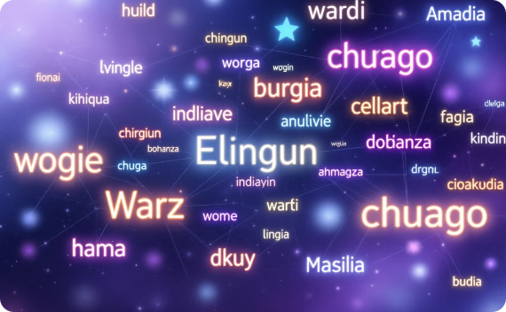
The Future of NLP
The future of Natural Language Processing is brimming with exciting possibilities. As we look ahead, we can anticipate significant advancements in several key areas. One major trend is the development of more sophisticated multimodal NLP systems that can integrate language understanding with other forms of data, such as visual and audio inputs. This integration will enable more human-like understanding and interaction capabilities in AI systems.
Another important direction is the focus on more efficient and environmentally friendly NLP models. As the size and computational requirements of state-of-the-art models continue to grow, there's an increasing emphasis on developing smaller, more efficient models that maintain high performance while reducing energy consumption and carbon footprint. Additionally, we can expect continued progress in multilingual and cross-lingual NLP, breaking down language barriers and enabling more inclusive global communication. As these technologies advance, they will likely transform various sectors, from healthcare and education to business and scientific research, opening up new possibilities for human-computer interaction and knowledge discovery.
Multimodal NLP
Efficient NLP Models
Advanced Multilingual NLP
Integrating language processing with visual and audio data for more comprehensive understanding
Developing smaller, more environmentally friendly models without sacrificing performance
Breaking down language barriers with improved cross-lingual understanding and generation

